Slide 1
PROJECT REPORT
//01
ENABLING BIG DATA WITH CI/CD
Submitted to:
MCIT
Author:
Trisha Solanki

Slide 2
Project Report
Company Introduction
03
Challenge Summary
04
Focused Areas
05
GAP Analysis
07
Stakeholder Mapping
10
Project Scope
11
Assumptions, Risks, Constraints
12
Use Case Diagram
13
Automating Analytical workflow
14
BPMN
15
Sprint Planning
16
Roadmap
17
Contents
//02

Slide 3
About
HealthCare Insurance
The company is one of the largest Health Insurance companies in the Canada and offers a wide range of primary health insurance products (single and family plans) to businesses (employees) and individuals.
This publicly operated company currently has over 3500 employees in total and has revenue of over $20 billion over its various business units and 18 branches throughout Canada.
//03
COMPANY INTRODUCTION
Project Report

Slide 4
//04
BUSINESS CHALLENGE
HealthCare runs a fine range of databases consistently on daily basis. These databases need to frequently be managed, monitored, and upgraded manually since the company runs on old legacy systems.
The main challenge is to make the data operations faster in day-to-day basis. These operations need a lot of employees and company feels it's becoming costly to manage such workflow.
Project Report

Slide 5
//05
Project Report
Focused Areas
THERE ARE 4 MAJOR ASPECTS WHICH NEED TO BE ADDRESSED
As the company tried to solve the issue of implementing faster workflow by hiring more Data Practitioners, but it did not solve the issue and it stared costing further and further.
Technical Aspects

Slide 6
//06
Project Report
COST
TIME
DEFECTS
MANUAL LABOR
It has become costly for the company to manage the workflow amidst the constant need of more people as the work is increasing day by day. In addition, the cost of maintaining the old systems is also increasing.
It takes a lot of time to perform all the data operations manually. Majority of employees' time is spent on basic operations which slows the company's performance.
As the tasks are performed manually, it is difficult to find any defects. It takes a lot of time to find the root cause of the errors manually. Human errors make it slower and costlier for the company.
Since the customers are increasing, the workload is also increasing. Among the increasing work, company needs to hire more people to keep up with all the operations and it costs the company more.

Slide 7
GAP Analysis
Project Report
HealthCare Insurance does not have any automated workflow and all the work is done manually
HealthCare Insurance has a Cloud-based infrastructure to handle Big Data challenges with CI/CD
Current State
Future State
//07

Slide 8
//08
Project Report
Context:
Transformation
(Enhancements)
Change:
Enabling Big Data with CI/CD
Stakeholders:
Management Body, Customers, Front-line Employees, BA, PM, Technical Team
Need:
To optimize the workflow and manage data in a better way and more securely
Business
Analysis Core Concept Model (BACCM)
Solution:
Enhance the infrastructure by changing legacy IT environment
Value:
Optimized, Secure, and Reliable infrastructure and smooth work environment

Slide 9

Goal Chart
Strategy
Q1
Q2
Change Legacy Systems (Manual to Automated)
Q1 - High Value
Low Effort
Q2 - High Value
High Effort
Q3 - Low Value
High Effort
Q4 - Low Value
Low Effort
High
Eliminate Maintenance cost of Data Server
Setup CI/CD environment
VALUE
Medium
Q4
Q3
Increase Workflow Security
Low
Automated Analysis Services
//09
Low
Medium
High
EFFORT

Slide 10
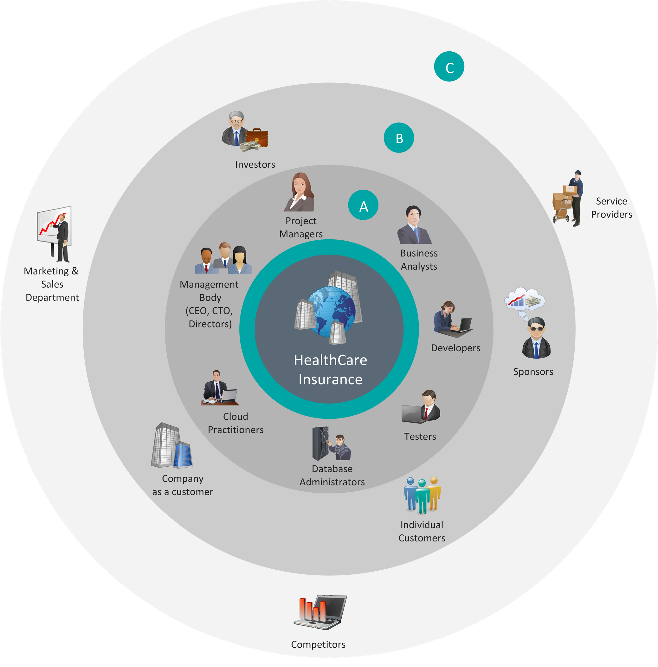
Project Report
Stakeholder Mapping
A
Internal Stakeholders
B
External (direct) Stakeholders
C
External (indirect) Stakeholders

Slide 11
Project Report
//11
A new work environment
Deployment of latest tools & technologies
An automated custom CI/CD workflow
Cloud based services and tools
Big Data to handle complex Data requirements
Latest Backup and Monitoring tools
Eliminate Hardware Data Storage (on premises storage)
Hiring Data Engineers
Training for Data Team
Account setup, Permission assignments, and other security tasks
In Scope

Slide 12
Project Report
//12
Assumptions
Risks
Constraints
New legacy systems and workflow will be easy to adapt
Anyone will be able to use it once the training is given
Fast & Secure operations will be performed compared to old systems
Cyber-security attacks
May be difficult to adapt for senior employees
Automating the wrong processes first
Lack of coordination between continuous integration and continuous delivery
Workflow should be as simple as possible
Cloud services should be selected from which are available in the market
Resource utilization should be done properly for existing and new tools

Slide 13
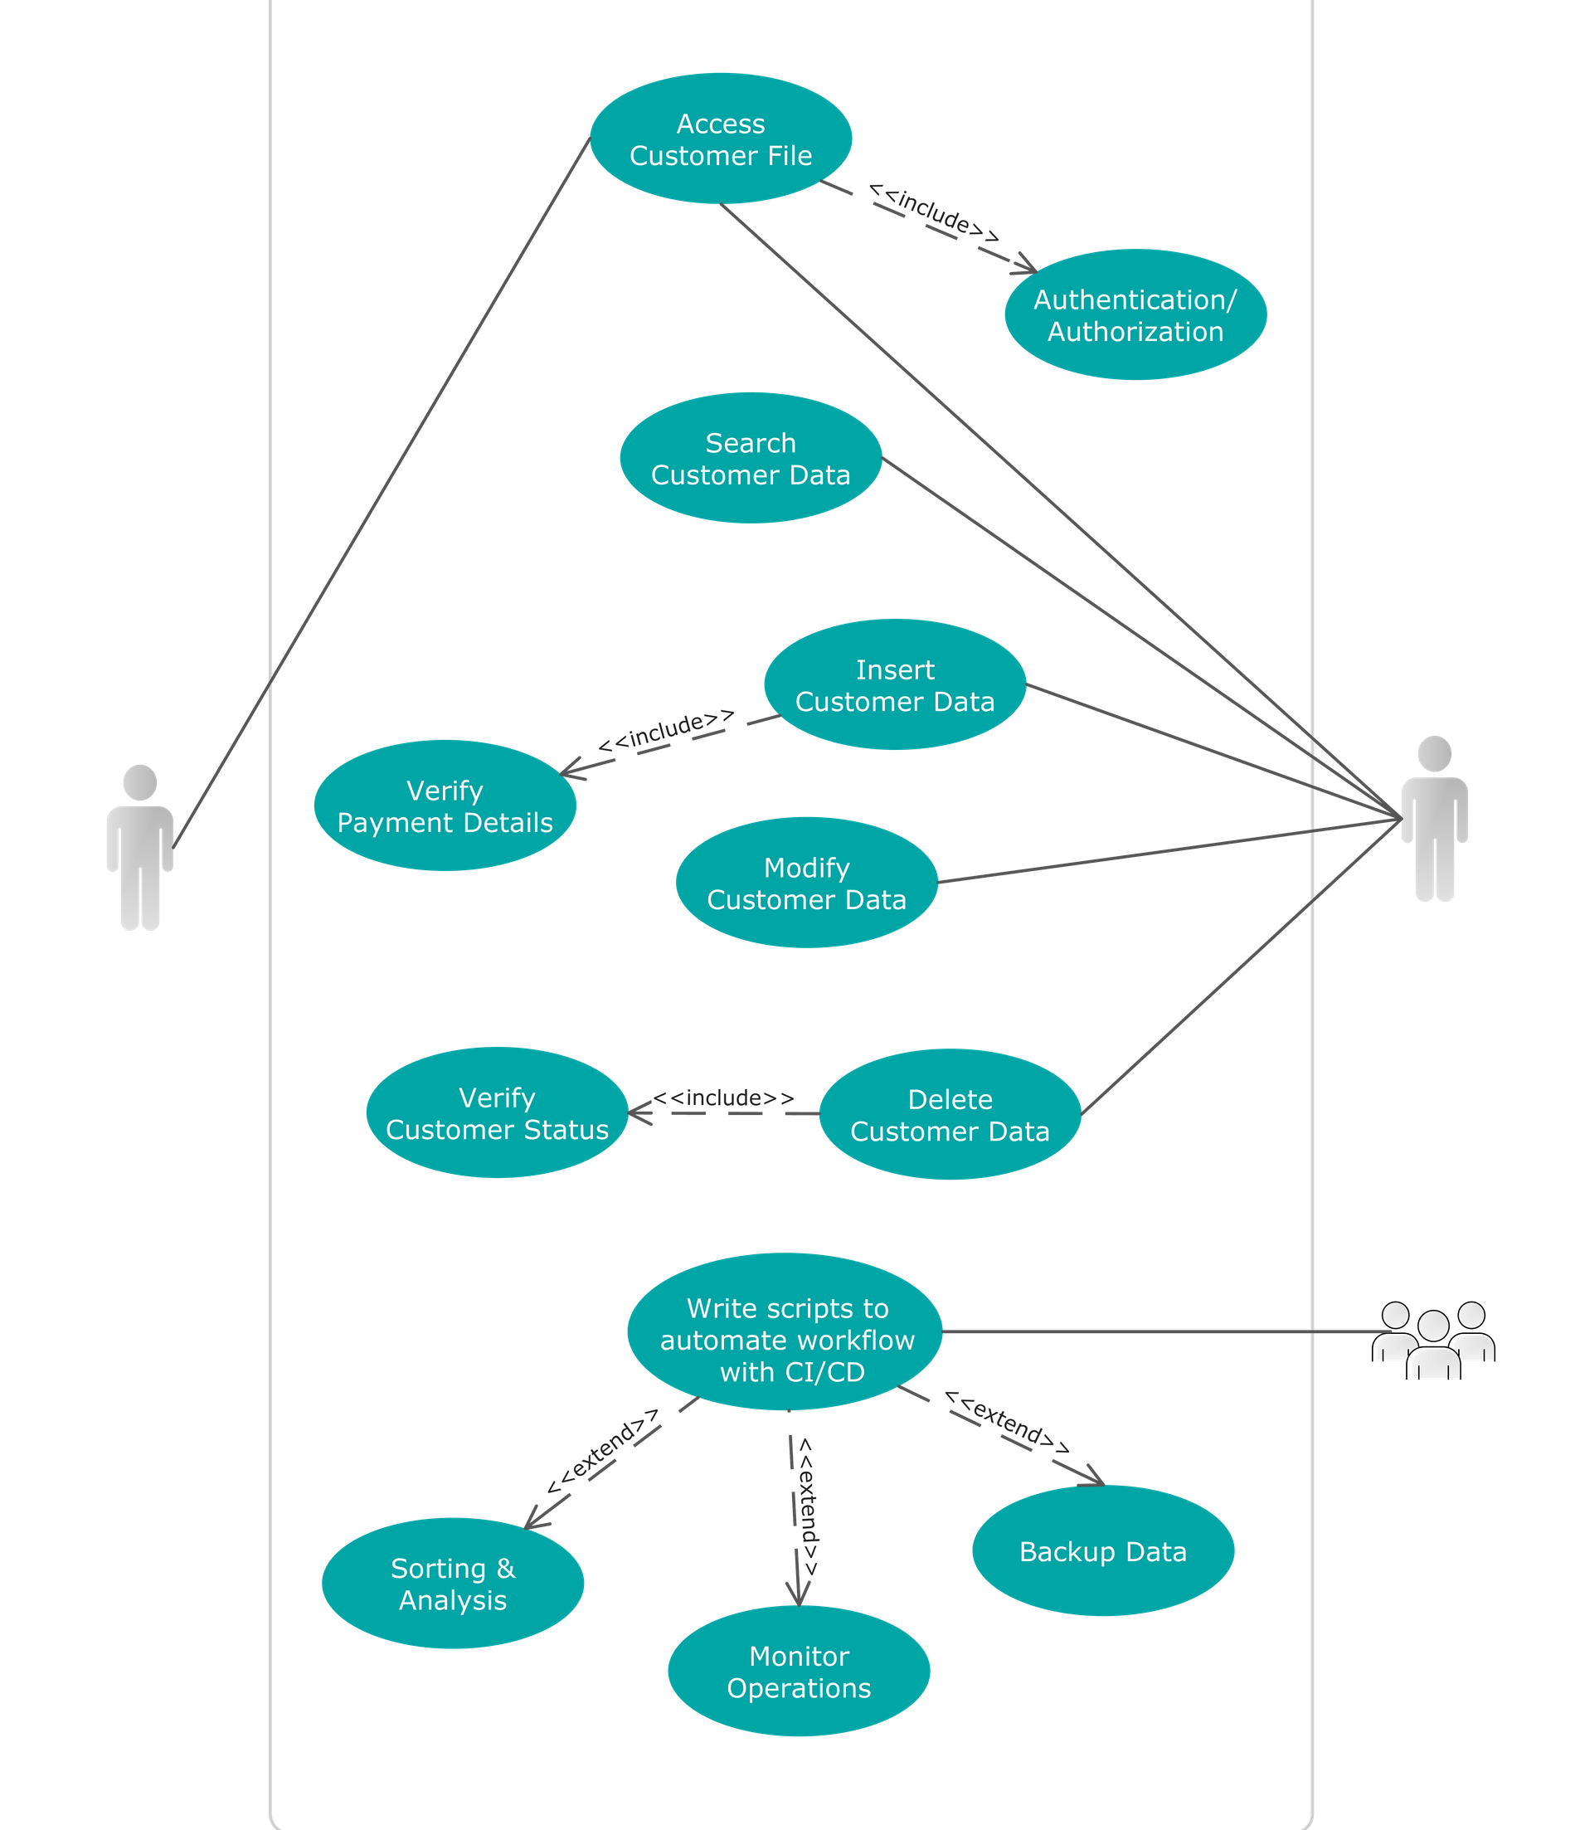
Use Case Diagram
Project Report
It shows how system interacts with Actors including internal and external influences.
//13

Slide 14
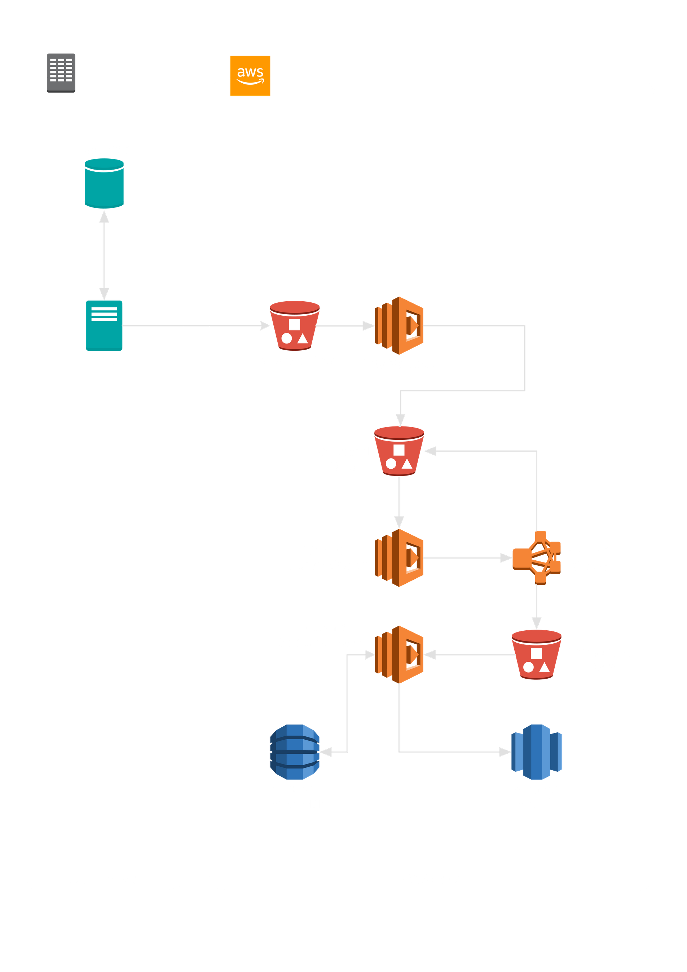
Automating Analytical workflow
//14
This is how data will move in an automated workflow and analyzed automatically without any manual help.
Project Report

Slide 15
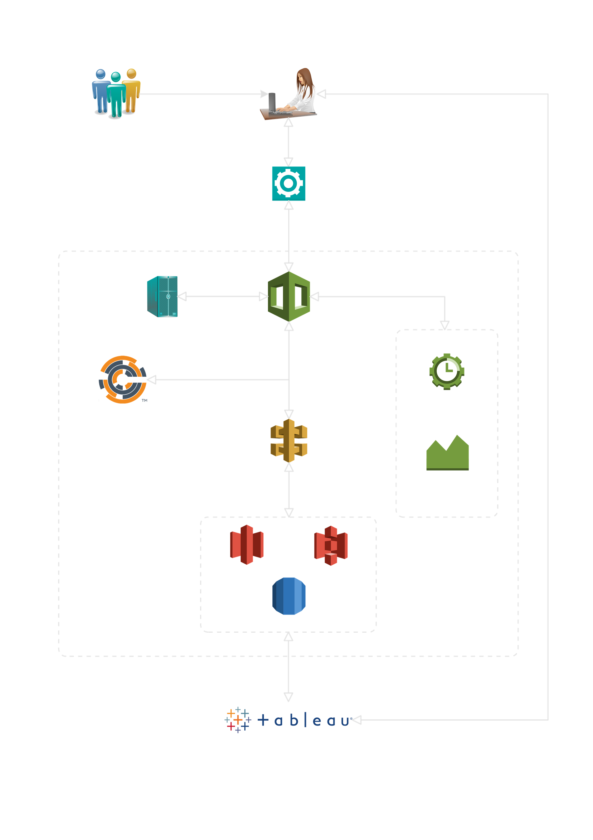
Proposed Solution
//15
This is a an overall proposed workflow of data operations throughout the company architecture
Project Report

Slide 16
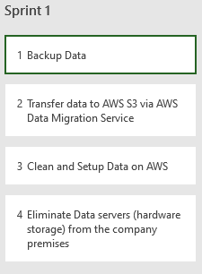
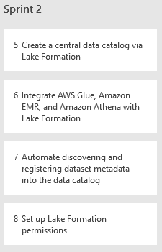
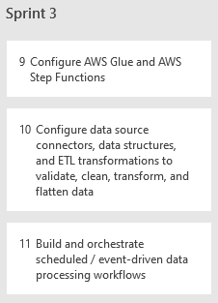
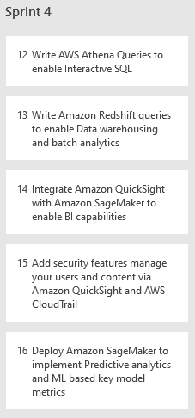
Sprint Planning
//16

Slide 17







Roadmap
Backup Data &
Data Migration to AWS Cloud
Create multi-step CI/CD pipelines to automate workflow
Add a layer of security & governance
Configure Predictive analytics and machine learning services
Setup Data Cataloging & Searching on
AWS Cloud
Enable automated Big Data
analytics services
Handling errors in pipelines & troubleshooting

Slide 18
Project Report
Thank You
//18
PHONE NUMBER
123-456-7890
EMAIL ADDRESS
trisha@healthcarein.com
QUESTIONS OR COMMENTS ?
WEBSITE
www.healthcarein.com

